Slide 1
Integrated framework for educational material
development based on linked data supporting learning analytics
Ma Chenguang
Okada Lab
Master Student
Department of Informatics, Graduate School of Information Science & Electrical Engineering,
Kyushu University, JAPAN

Slide 2
Outline
The background and objective of research
Overview of educational material development framework
Introduction of methodology and implementation
Conclusion and future work
Reference

Slide 3
Outline
The background and objective of research
Overview of educational material development framework
Introduction of methodology and implementation
Conclusion and future work
Reference

Slide 4


The background of research
E-Learning plays an important role in higher education.
Information communication technology
①Allowing learning to be individualized
②Enhancing learners’ interactions
③Transforming the role of the teacher
……

Slide 5

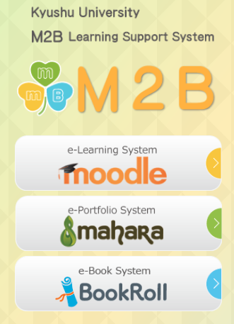
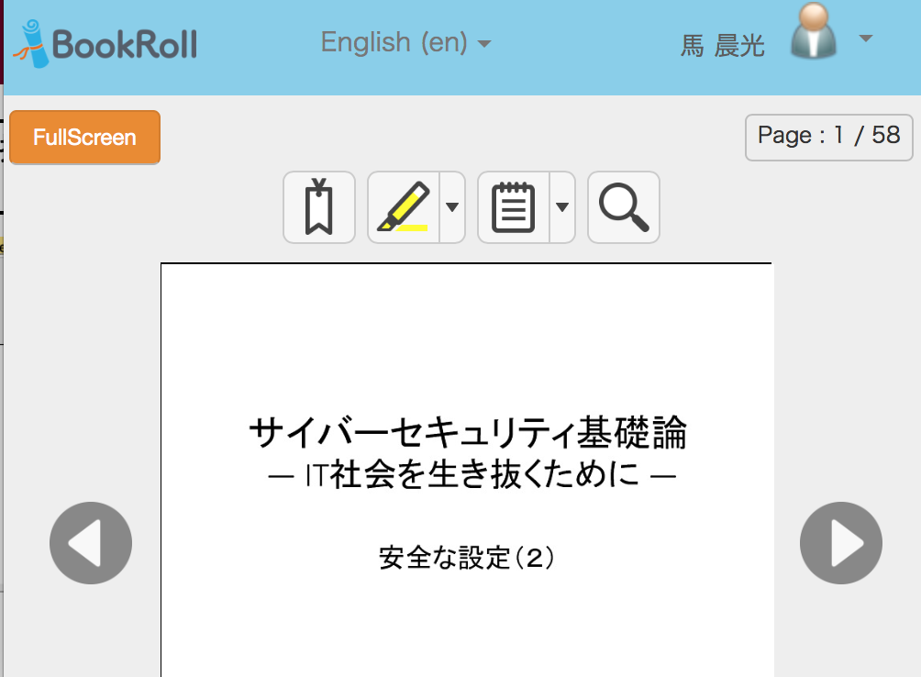
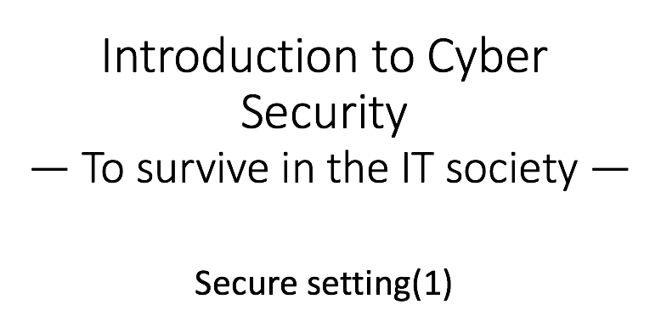
The background of research
Kyushu University:①BYOD(Bring Your Own Device)
②M2B(MITSUBA)e-Learning Management System
View
Note
Highlight
Bookmark
BookRoll – e-Book distribution system

Slide 6
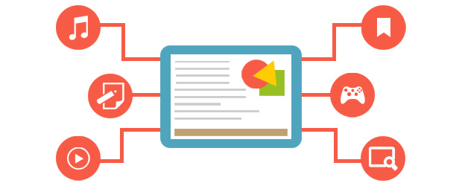


The purpose of the study - Development framework for electronic educational material
Research objective
Proposing an integrated framework for educational material development to support teachers develop electronic educational material efficiently and conveniently.
？WHAT format
PDF format
->
ePub format
？HOW to edit
？HOW to view
Music
Bookmark
Authoring tool based on linked data
Web-based viewer for ePub format material
Text
Game
Video
Search
Web-based viewer supporting learning analytics
Development
Distribution
Teachers
Reading log
Students
？HOW to obtain feedback

Slide 7
Outline
The background of IoT security project &education
Overview of educational material development framework
Introduction of methodology and implementation
Conclusion and future work
Reference

Slide 8
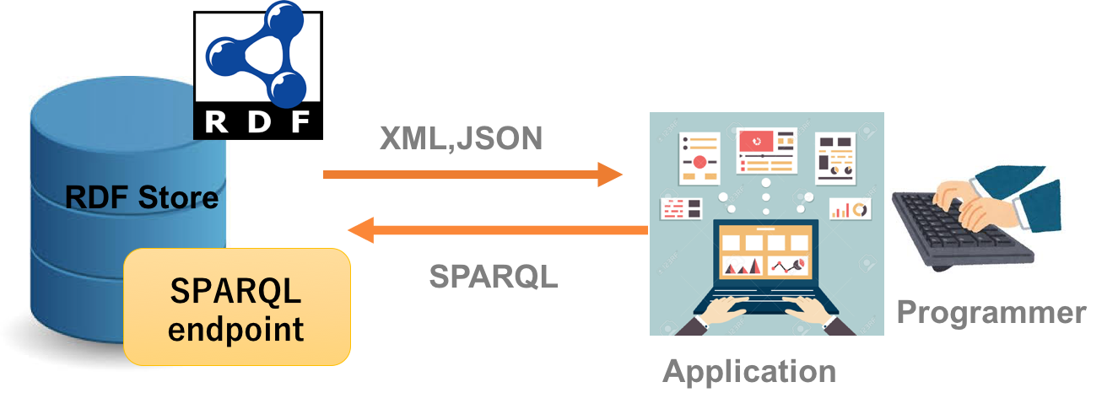
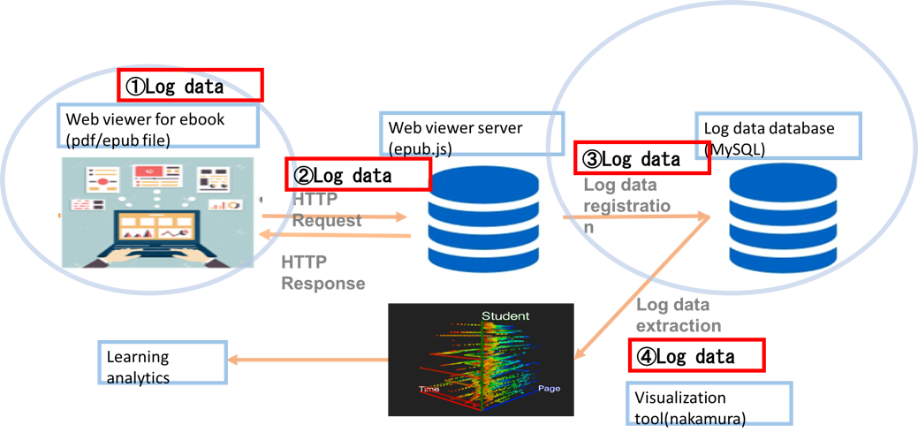
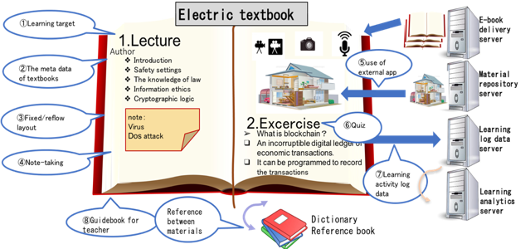
Overview of educational material development framework
①How to collect , manage and edit the knowledge for electronic teaching material ?
②What kind of e-book format can be used to support multimedia contents?
③How can students view the electronic material created and distributed by teacher conveniently?
④How can teachers obtain and make good sense about feedback from students after they reading the educational material distributed by them?
Authoring tool based on linked data①(M. Chenguang and Y. Okada etc. iCERI 2017 )
ePub viewer supporting Learning Analytics③④ (M. Chenguang and Y. Okada etc. INTED 2018 )
ePub format eBook supporting multimedia contents②

Slide 9
Outline
The background of IoT Security project &education
Overview of educational material development framework
Introduction of methodology and implementation
Conclusion and future work
Reference

Slide 10
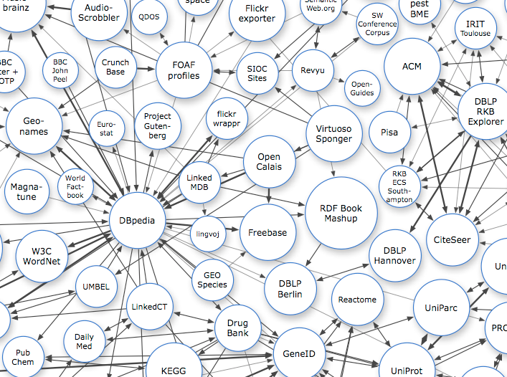
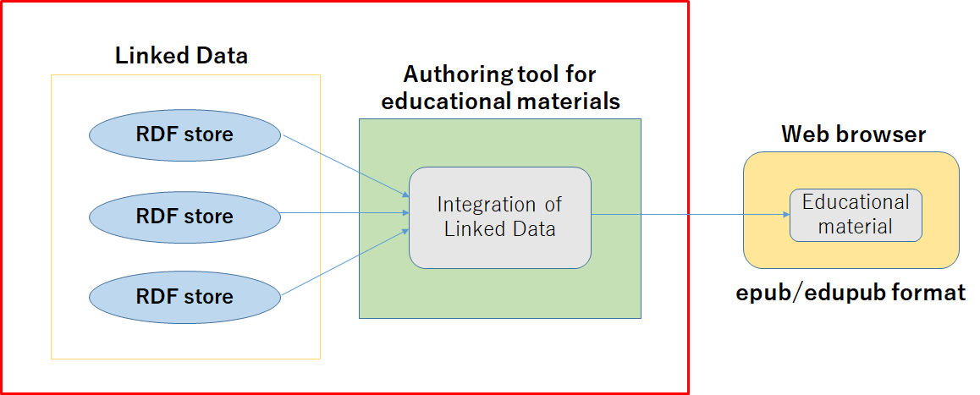
Introduction of methodology and implementation
①How to collect , manage and edit the knowledge for electronic teaching material ?
①Linked Data Technology and Authoring tool
Linked Data Store
The authoring tool (H. Takubo 2017)

Slide 11
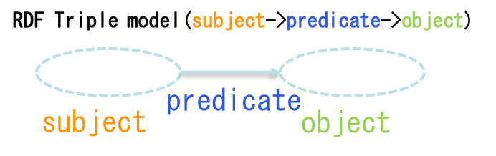
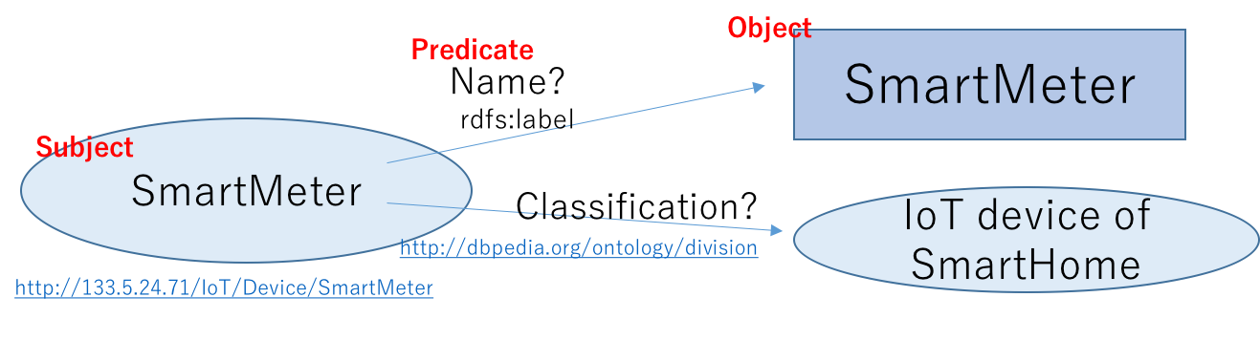
Introduction of methodology and implementation
①Contextual knowledge management based on linked data
Linked Data – RDF（Resource Description Framework）
A data model for representing information of resources in web.
Definition of a data entity(e.g. SmartMeter)

Slide 12
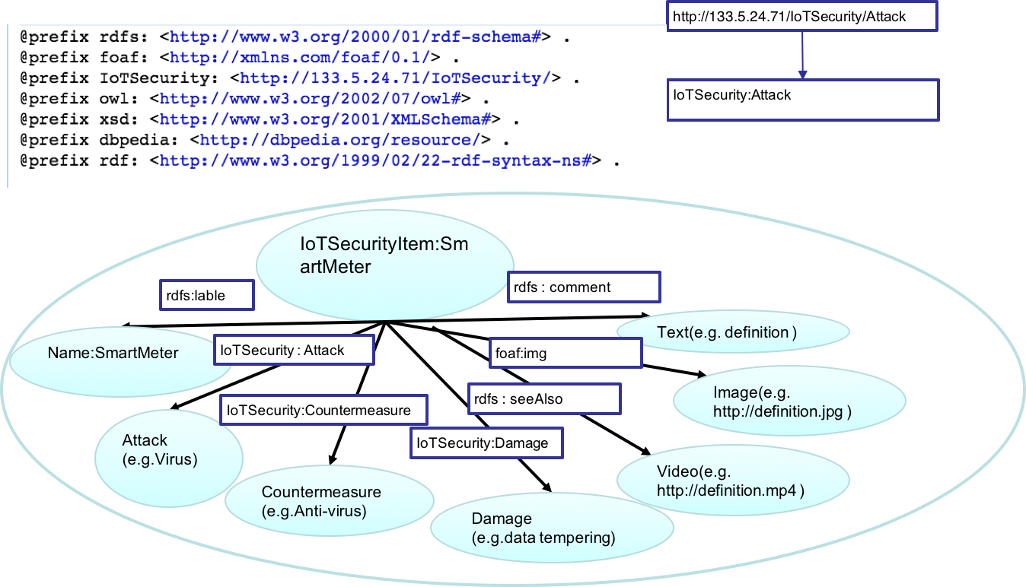

Introduction of methodology and implementation
① Contextual knowledge management based on linked data
Implementation of RDF server for information (e.g. IoT security )
Design of RDF data - Manage information as RDF format(e.g. IoT security )
IoT security
information collection
Schema table: Triples of conceptual design
Instance table: Table data entered in Excel format
Prefix table: Definition of the namespace to be used.
Prefix
Schema
Instance
RDF store schema

Slide 13
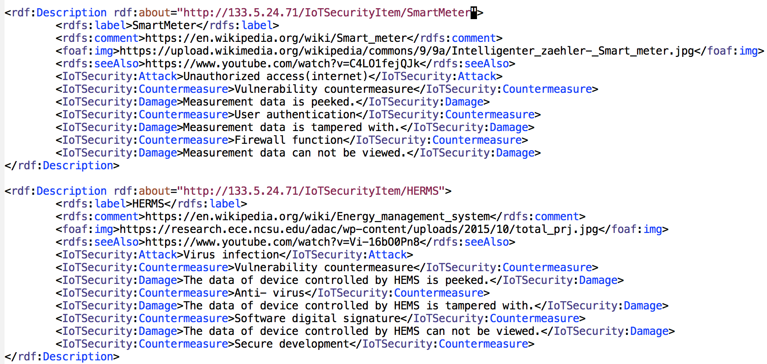
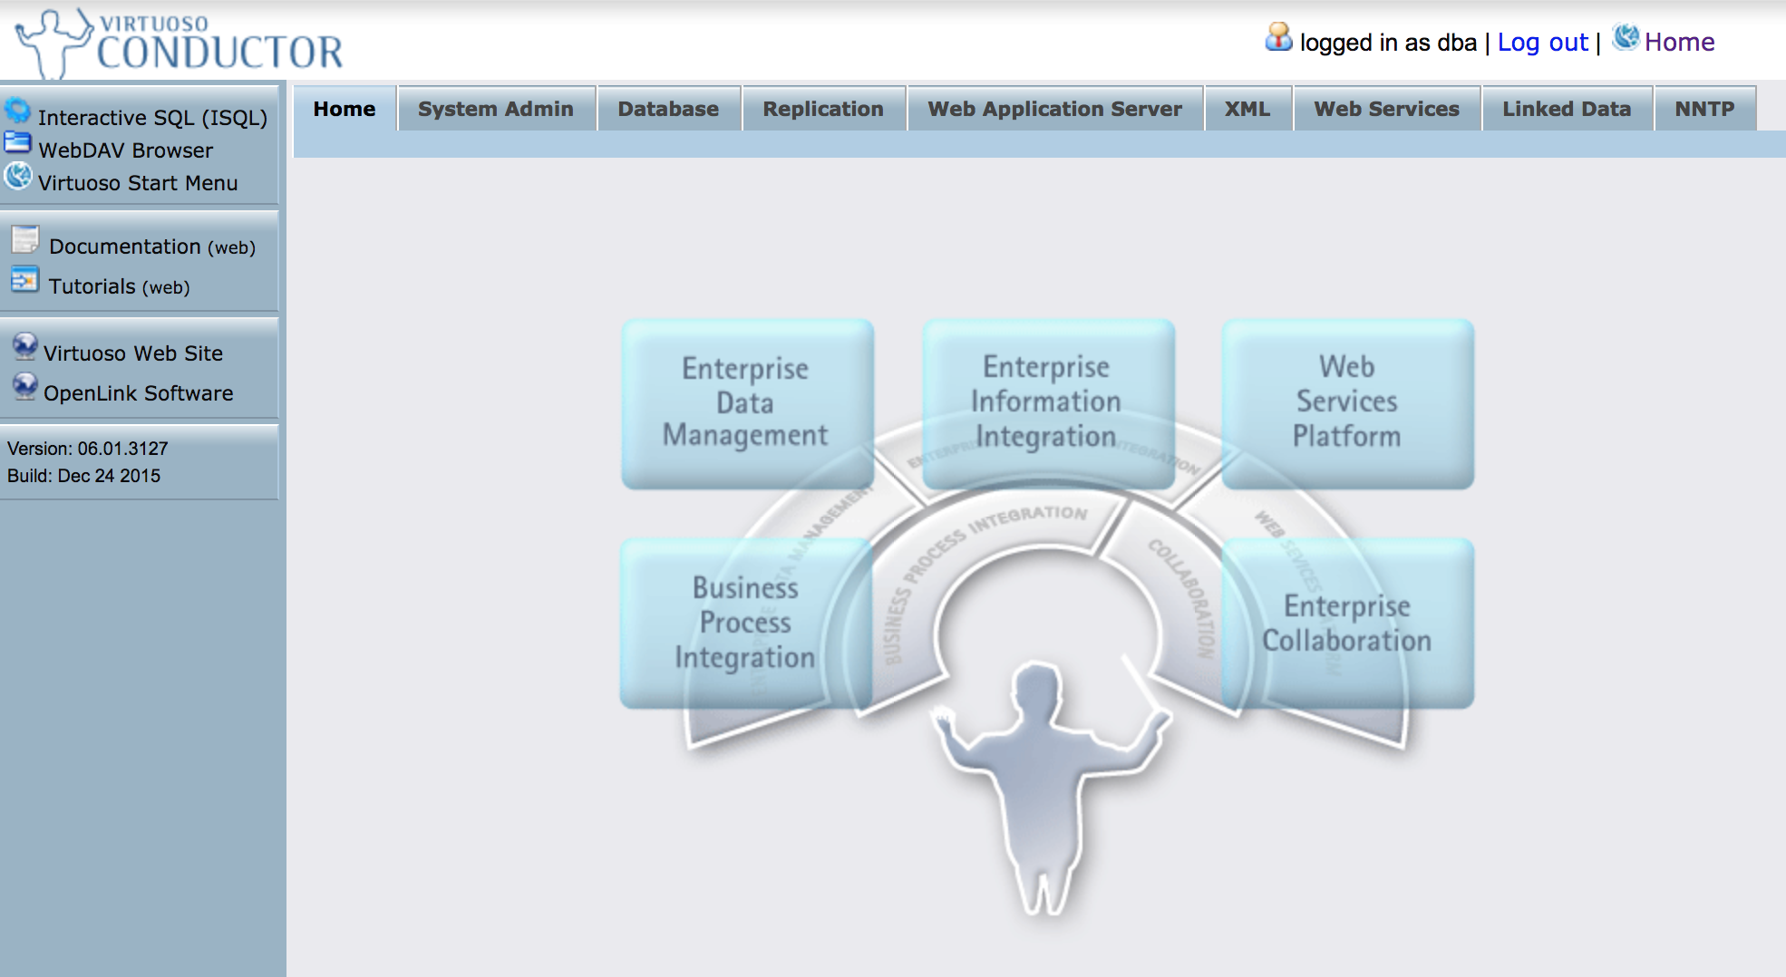
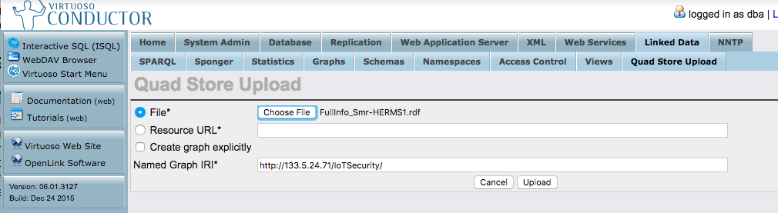
Introduction of methodology and implementation
① Contextual knowledge management based on linked data
Implementation of RDF server for IoT security information
Registration of RDF file
Exported RDF file
Storage of RDF file

Slide 14
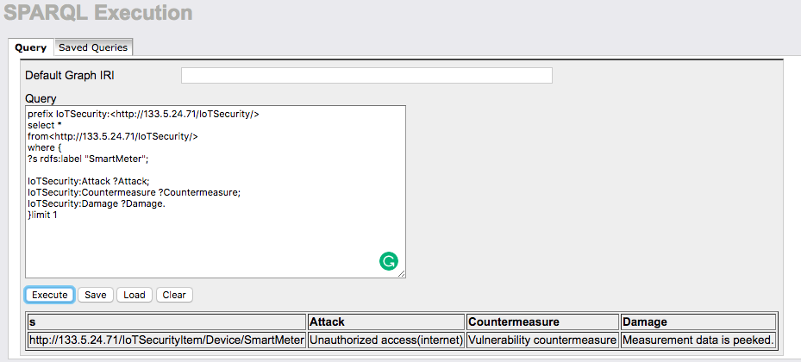
Introduction of methodology and implementation
① Contextual knowledge management based on linked data
Implementation of RDF server for IoT security information
Retrieval data with SPARQL in endpoint(Virtuoso)
Search Query
Result
Retrieval of RDF file

Slide 15
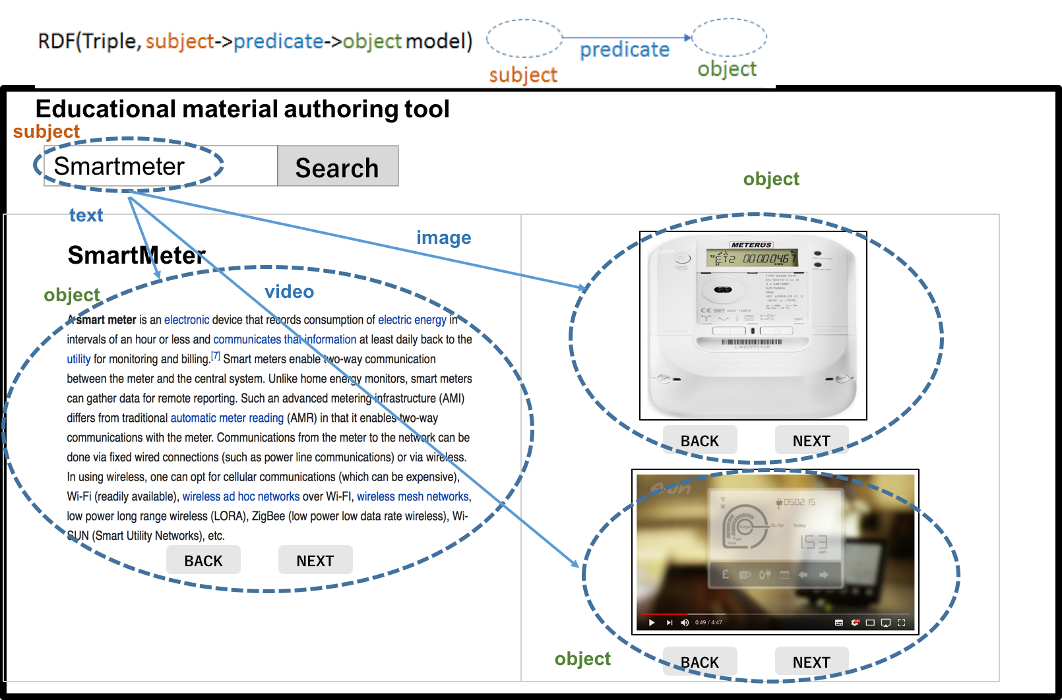
Introduction of methodology and implementation
① Edition for educational material based on authoring tool
Prototype system of authoring tool for IoT Security

Slide 16
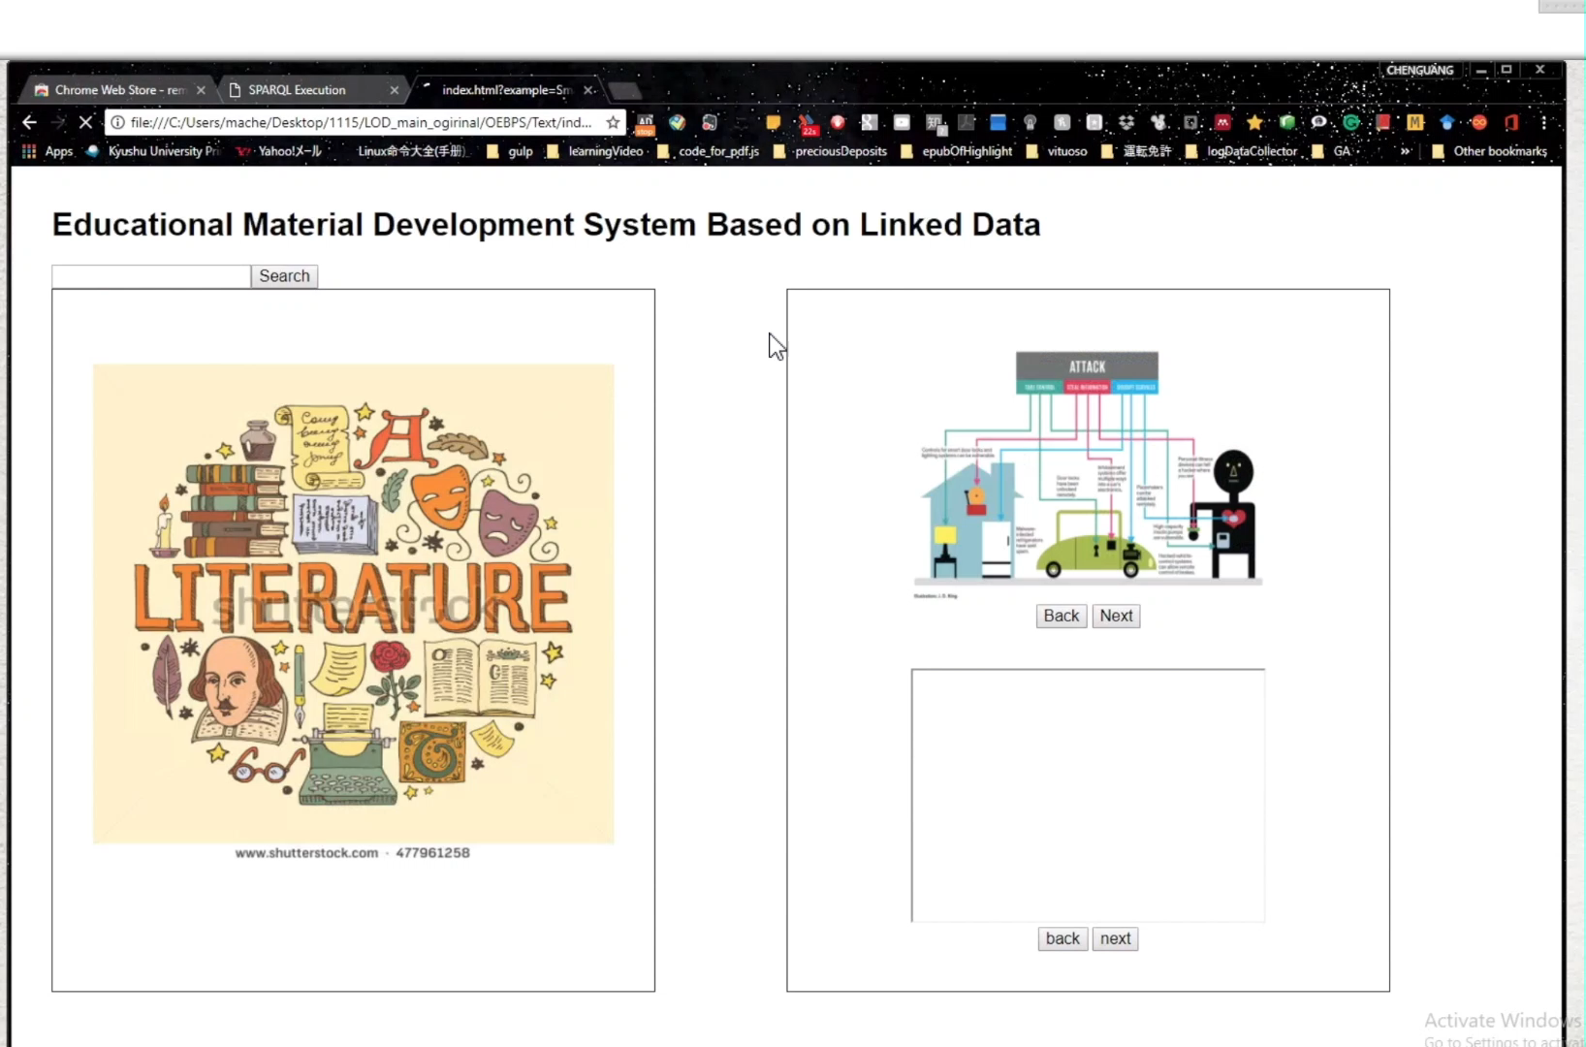
Introduction of methodology and implementation
① Edition for educational material based on authoring tool
Demo of authoring tool for IoT Security

Slide 17
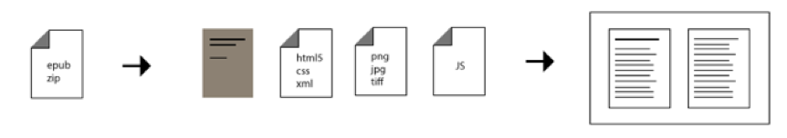
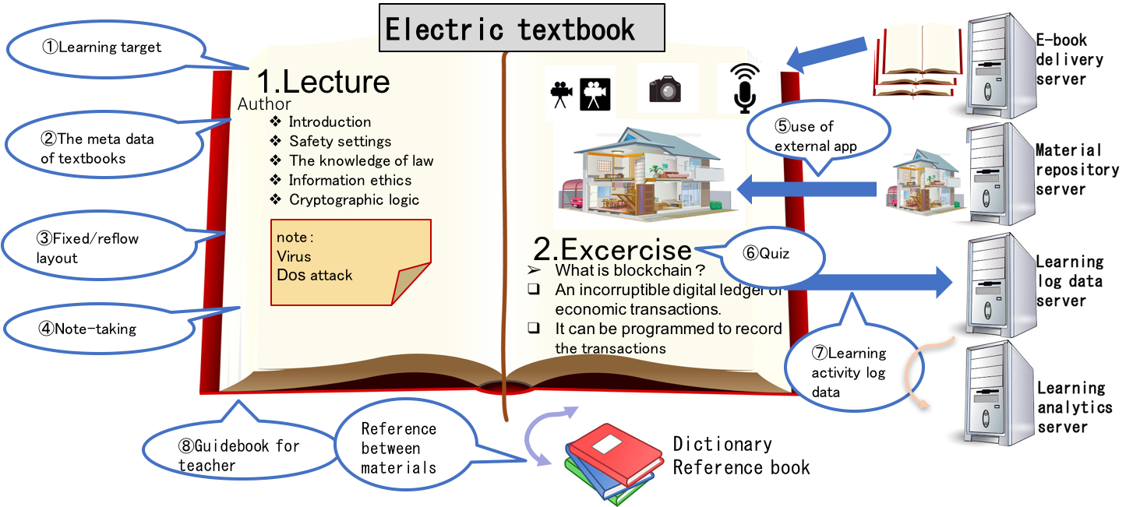
Introduction of methodology and implementation
② What kind of e-book format can be used to support multimedia contents?
② ePub format-The standard of publishing the electronic textbook
The architecture of ePub

Slide 18
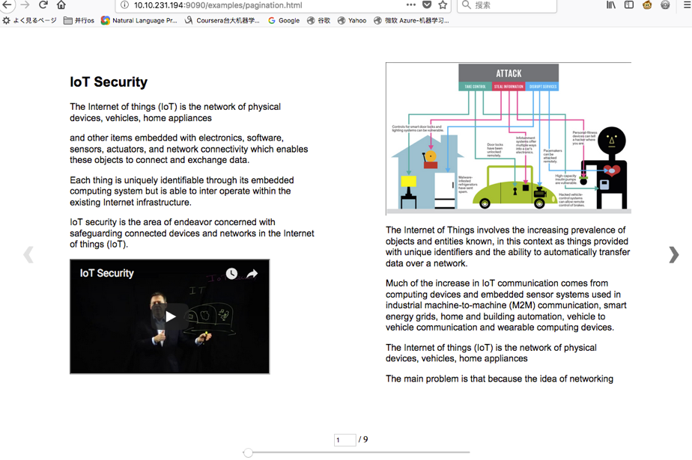
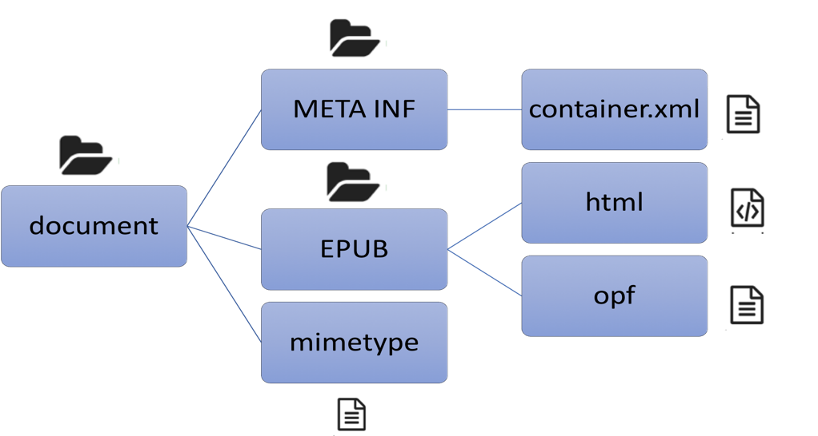
Introduction of methodology and implementation
③ How can students view the electronic material created and distributed by teacher conveniently?
③ Web-based viewer for ePub format book by utilizing ePub.js
The component of ePub format book.
Web-based viewer for ePub format book

Slide 19
Introduction of methodology and implementation
④ How to obtain feedback from students after they reading the educational material?
④ Web-based viewer supporting learning analytics.
The architecture of web-based viewer supporting learning analytics.

Slide 20
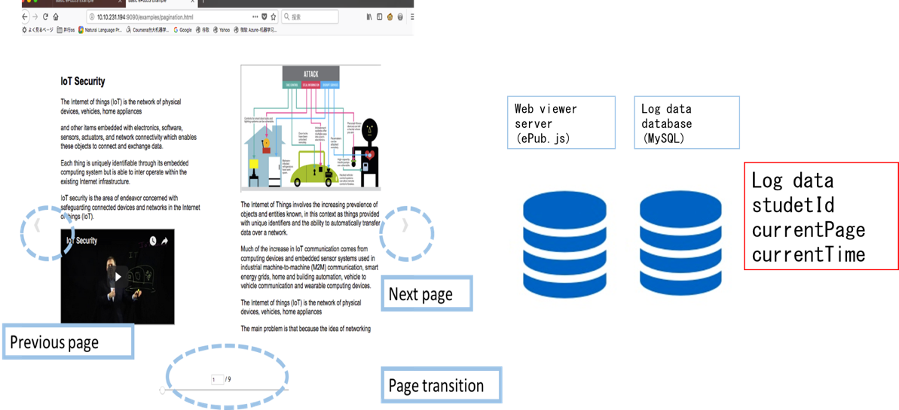
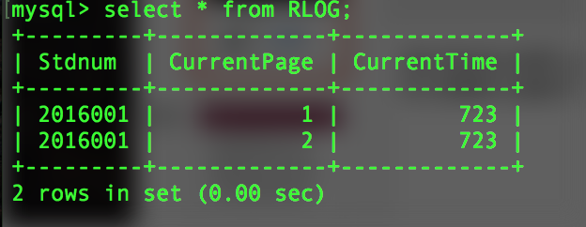
Introduction of methodology and implementation
④ How to obtain feedback from students after they reading the educational material?
④ Web-based viewer supporting learning analytics.
The implement of architecture for reading log data extraction.

Slide 21
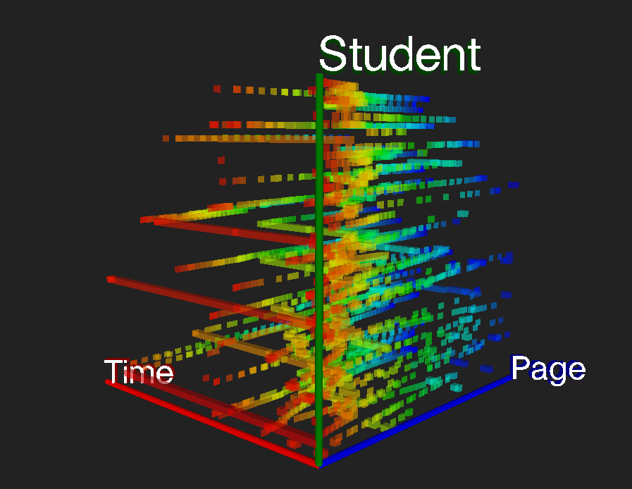
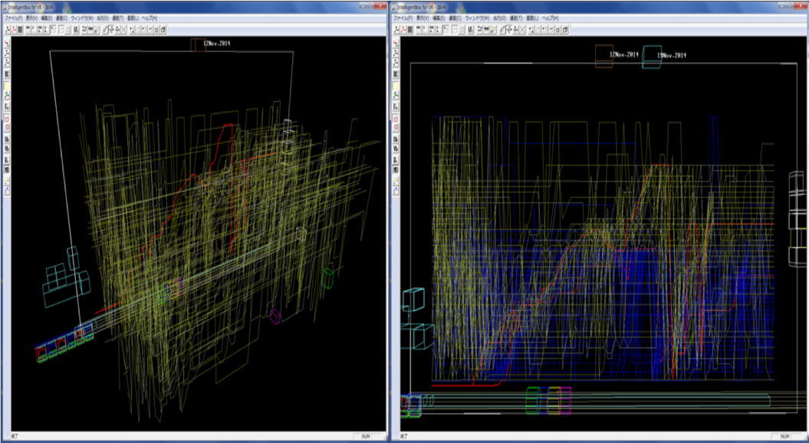
Introduction of methodology and implementation
④ How to obtain feedback from students after they reading the educational material?
④ Web-based viewer supporting learning analytics.
Visualization of Activity data of all students by Cubic Gantt Chart.(Nakamura, S. Okada, Y. etc. ICCE2015)
Visualization of Activity data of all students by Time Tunnel. ( Nakamura, S. and Okada, Y. INTED 2017 )

Slide 22
Outline
The background of IoT Security project &education
Overview of educational material development framework
Introduction of methodology and implementation
Conclusion and future work
Reference

Slide 23
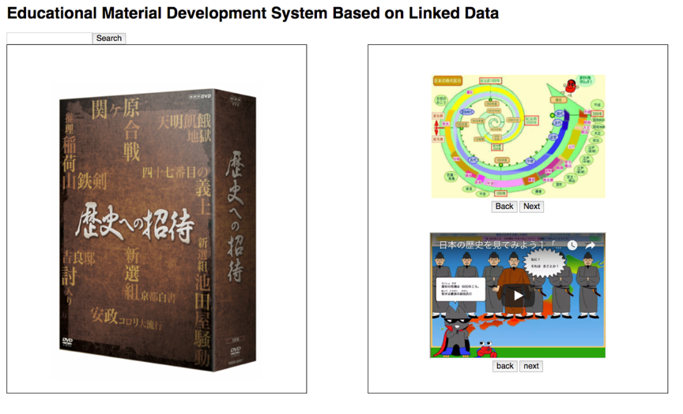
Conclusion and future work
Conclusion
An integrated educational material development framework based on linked data supporting learning analytics to support teachers to develop the educational material efficiently and conveniently was proposed.
①ePub Book
②Book viewer supporting LA
The implement of authoring tool for Japanese history.
The implement of architecture for reading log data extraction.

Slide 24
Conclusion and future work
Future work
Generating ePub format book automatically.
More various learning activities information are able to be contained, such as notion, highlight, bookmark, session information and so on.
Supporting to enhance learning and teaching based on learning analytics by collecting various educational big data from e-book.

Slide 25
Main Reference
[1] M. Chenguang, S. Kulshrestha, S. Wei, Y. Okada, and R. Bose, “LEARNING ANALYTICS FRAMEWORK FOR IOT SECURITY EDUCATION.”
[2]Ma Chenguang, Srishti Kulshrestha, Shi Wei, Yoshihiro Okada, Ranjan Bose, EDUCATIONAL MATERIAL DEVELOPMENT FRAMEWORK BASED ON LINKED DATA FOR IOT SECURITY, in iCERI 2017, 16-18, Nov., 2017.
[3] H. Takubo, “Educational Material Development System Based on Linked Open Data (in Japanese)”, Graduation thesis, Faculty of Science, Kyushu University (2017).
[4] Nakamura, S. and Okada, Y. : Learning Analytics Using BookLooper and Time-tunnel, INTED 2017, pp. 8767-8776.
[5] Nakamura, S., Kaneko, K., Okada, Y., Yin, C. and Ogata, H. : Cubic Gantt Chart as Visualization Tool for Learning Activity Data, The 1st workshop on e-Book-based Educational Big Data for Enhancing Teaching and Learning of ICCE2015, pp. 649-658.

Slide 26
Thanks for your attention!

Slide 27
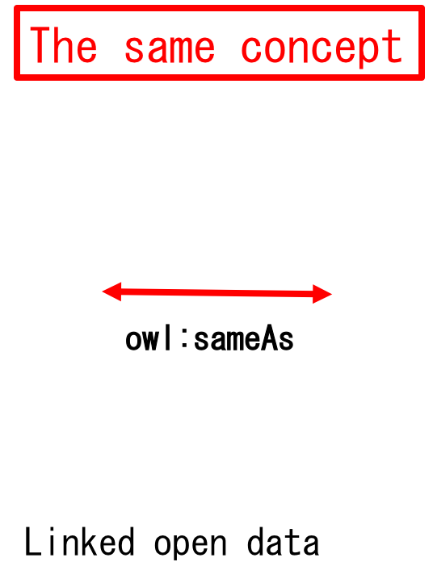
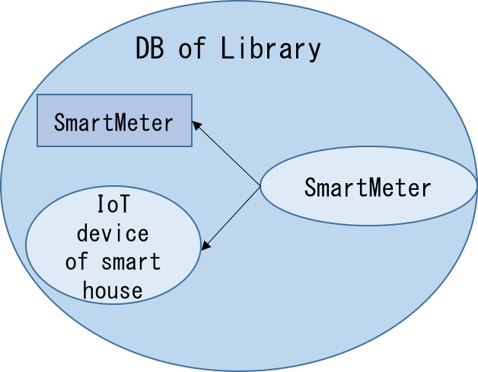
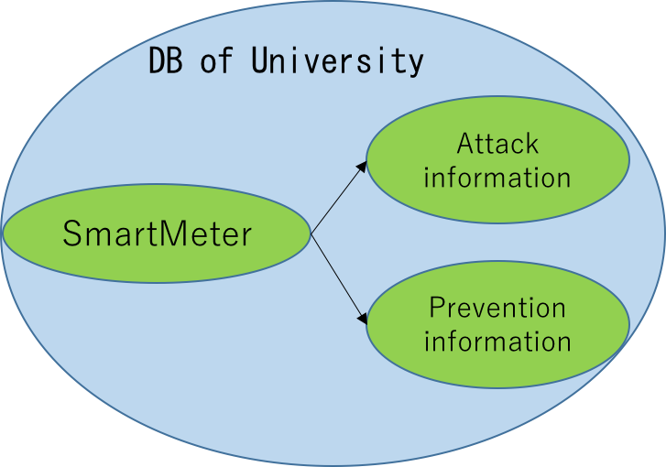
Introduction of methodology and implementation
① Contextual knowledge management based on linked data
Link the same data entity saved in different database
Owl(the w3c web ontology language)

